Slide 1
Predictive Modeling - Prudential Life Insurance Assessment
Ashok Bhatraju – 670248723
Nikita Bawane – 661069000
Ritu Gangwal - 670646774

Slide 2

AGENDA
Prudential life Insurance - Overview
Dataset Description
Data cleanup and exploration – feature engineering
Model Evaluation and Comparison
Future Considerations
Key Findings & Conclusion

Slide 3
Prudential Life Insurance needs to evaluate and identify the risk classification and eligibility, given the data of clients.
PRUDENTIAL LIFE INSUARANCE – OVERVIEW AND BUSINESS VALUE
Present Situation
Life insurance market size in US is 900 Billion Dollar as of 2020. Prudential life contributes to 5.50% of this, placed at 4th in the list of market leaders.
Prudential uses this information for risk classification, scheduling medical exams and deciding eligibility.
The antiquated application process results in low insurance penetration levels.
For instance, only 40% households in the USA have insurance.
This process takes an average of 30 days
Need of Modelling – Automating the process
Given this current trend of insurance industry and based on customer requirement, we need to develop a predictive model to classify high risk and low risk applicants .
Results in making the process of identifying target customer segment quicker and less labour intensive while maintaining privacy boundaries.
Improve public perception of the insurance Industry and will Increase household penetration

Slide 4

Dataset Description and Feature Engineering
Variable | Description | Variable Treatment Summary
ID | A unique identifier associated with an application | This variable is not important in model development as it is just a reference variable.
Product_info_1-7 | A set of normalized variables relating to the product applied | All these variables are treated firstly through missing values, replacing these missing values, removing correlation and then applying random forest method to get the important variables.
Ins_Age | Normalized age of applicant
Ht | Normalized height of applicant
Wt | Normalized weight of applicant
BMI | Normalized BMI of applicant
Employment_info_1-6 | A set of normalized variables relating to the employment history of the applicant
Family_Hist_1-5 | A set of normalized variables relating to the family history of the applicant
Insuredinfo_1-7 | A set of normalized variables providing information about the applicant
Insurance_history_1-9 | A set of normalized variables relating to the insurance history of the applicant | PCA method is applied for variable reduction along with all information restored.
Medical_History_1-41 | A set of normalized variables relating to the medical history of the applicant | Created new variable as "Medical History Sum" which is basically the sum of all 3 to 41 variables to restore all the information. This new variable will represent medical history of an applicant in total. Medical History 1 and 2 are left as it is as they have high values.
Medical_keyword_1-48 | A set of dummy variables relating to the presence of/ absence of a medical keyword being associated with the application | Created new variable as "Medical Keyword" which is basically the sum of all dummy variables to restore all the information. This new variable will represent total no. of medical keywords present for an applicant
Total attributes – 128 variables
Target Variable – Response with 8 levels. Converted this into binary variable- 0 for ranks 1 to 4 as "Low Risk Applicants" and 1 for ranks 5 to 8 as "High Risk Applicants" .
Total training set – 59,381 customers
Training dataset – 41,567 customers
Validation dataset - 17,814 customers
Test dataset - 19,765 customers
Reduced attributes – 26 variables

Slide 5
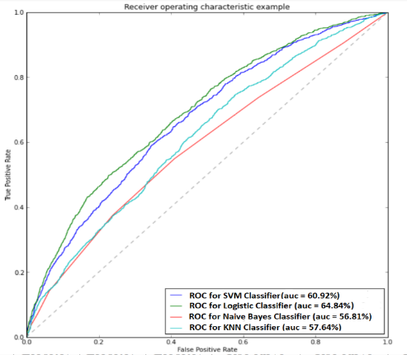
MODEL EVALUATION AND COMPARISON
Naïve Bayes - The naïve Bayesian classifier is based on Bayes theory and this model was used as the baseline. After tuning the parameters, the best accuracy was attained with Kernel = false, Laplace smoothening factor = 2 and adjust = 3.
K-Nearest Neighbors (KNN) - We used multiple K values to check which value gives us the best accuracy. In our case K = 29 gives the best accuracy for this model. Accuracy = 75.12
Logistic Regression - Used to predict the probability of occurrence of an event by fitting data to a logistic curve. Lasso (L2), Ridge (L1) and Elastic net was performed by varying alpha value and best was Ridge regression with 76.14% accuracy.
Support Vector Machine (SVM) – Performed for linear, radial, sigmoid and polynomial kernels and best was with radial kernels with parameters – Cost – 10^6, Gamma = 1.00E-05.
Considering all the evaluation factors like accuracy, sensitivity and ROC, the SVM model indicated the best performance with respect to other models with second best as Logistic Regression model.

Slide 6
Conclusion and Future Considerations
Key Findings & Conclusion
Future considerations
Exploring categories & methods
Accuracy for all four models was approximately same but sensitivity showed a huge progress from 21.99% in Naive Bayes to 95.32% in SVM.
ROC-AUC value increased from 56.81% from Naïve Bayes to 64.84% for Logistic regression.
The effect of hyperparameters on the prediction accuracy of different models was explored and dimensionality reduction (PCA and correlation) was applied as a preprocessing step to these models.
By investigating the prediction accuracy of different models after the PCA, it turned out PCA improved the performance of all models along with parameter tuning process.
Hence, for this dataset, SVM with radial kernel resulted in the best results in terms of accuracy, ROC and sensitivity.
a. Improve existing model in terms of accuracy by more in-depth analysis and implementing new mechanisms.
b. Research on additional categories such as medical history and medical keywords.
Performing customer segmention into groups with similar attributes by unsupervised learning techniques like Clustering and then implementing predictive models to contribute to a different data mining approach for the life insurance customer data set.
Unsupervised Learning
.

Slide 7
QUESTIONS
THANK YOU & STAY SAFE ☺

